Slide 1
Database System – Concepts and Architecture
Presenter: Ayush Tuladhar
Subject: DBMS
CSIT IV

Slide 2
Introduction
Database system environment
DBMS architecture:
Centralized architecture
Client/server architecture
Classification of database management systems

Slide 3
Database system environment
Hardware: Computers, storage devices, network infrastructures
Software: DBMS software, OS, network software, application programs
Data: Actual data stored in database, along with metadata
Procedures: Rules and instructions for managing database
People: End-users, application programmers, database administrators

Slide 4
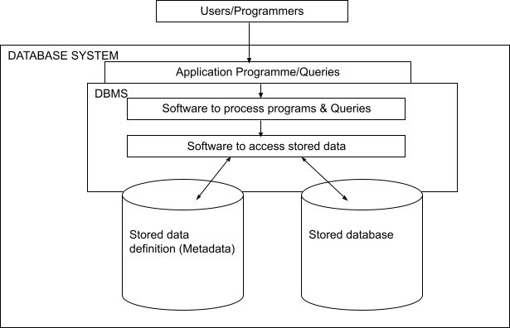
Database system environment

Slide 5
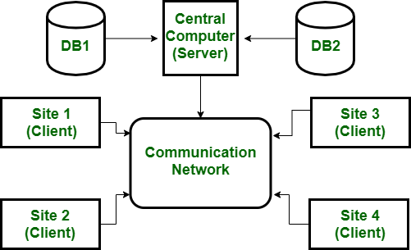
Centralized database system
All data is stored on a single computer (mainframe or server)
All processing occurs on that central machine
Users access the system through dumb terminals or client applications
Fig: Centralized architecture

Slide 6
Client/server architecture
Processing is divided between client machines and server machines
The database server manages data storage, query processing, and transaction management
Client machines handle user interface and application logic
Types of client/server architecture:
1-tier architecture
2-tier architecture
3-tier architecture

Slide 7
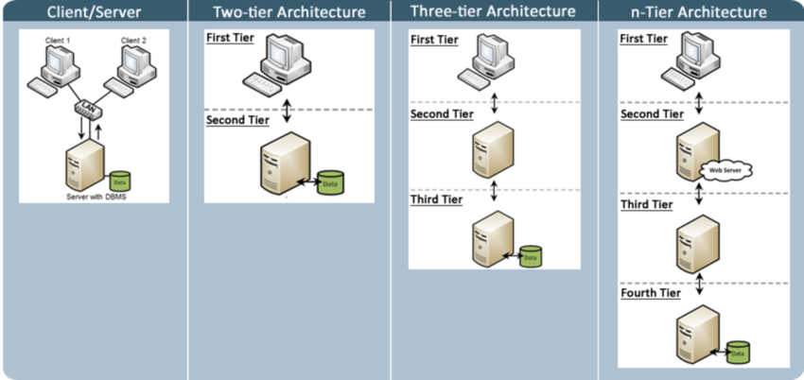
Types of client/server architecture

Slide 8
Centralized vs. client/server architecture
Aspect | Centralized DBMS | Client/Server DBMS
Control | Single point (mainframe) | Distributed (clients + server)
Processing Location | Entirely on mainframe | Split: Clients (UI/logic) + Server (data)
Resource Dependency | Terminals rely 100% on mainframe | Clients have independent processing power
Communication Flow | One-way (terminal ↔ mainframe) | Two-way (client ↔ server)
Failure Impact | Entire system crashes | Server failure affects clients only
Use Cases | Legacy systems (banks, airlines) | Modern apps (web, enterprise systems)

Slide 9
Classification of dbms
Data model
Number of users
Site location
Type of access path

Slide 10
Based on data model
Relational DBMS (RDBMS): Organizes data in tables (e.g., Oracle, MySQL, SQL Server)
Object-oriented DBMS (OODBMS): Stores data as objects (e.g., ObjectDB)
Hierarchical DBMS: Data organized in tree-like structure (e.g., IMS)
Network DBMS: Data represented as graphs with many-to-many relationships
NoSQL DBMS: Non-tabular data models (document, key-value, columnar, graph)

Slide 11
Based on number of users
Single-user: Supports only one user at a time (e.g., desktop databases like MS Access)
Multi-user: Supports multiple users concurrently (most enterprise DBMS)

Slide 12
Based on site location
Centralized: Data stored at single location
Distributed: Data distributed across multiple locations

Slide 13
Based on type of access path
Homogenous: Same DBMS at all sites
Heterogeneous: Different DBMS at different sites

Slide 14
Thank you

